Slide 1

SMART INDIA HACKATHON 2026
Problem Statement ID – 26141
Problem Statement Title- Quantum-Inspired Cyber Threat Detection for Digital Signature Security
Theme- Blockchain & Cybersecurity
PS Category- Software
Team ID- 159801
Team Name- TEAM ATHENA

Slide 2

HEDWIG
PROPOSED SOLUTION
Teleportation-Based QDS: Bell-state teleportation + Pauli corrections for secure signature transmission.
Quantum Threat Detection: Pauli measurements, state elimination, QBER and statistical thresholds detect attacks.
Message & Session Binding: Hash commitments protect against tampering, replay and impersonation.
Two-Tier Detection: Distinguishes channel attacks, signer manipulation and uncertain disturbances.
Quantum Circuit Breaker: WATCH, QUARANTINE, early abort and adaptive testing respond to threats.
Verifiable Audit Trail: Hash-chained records with optional Ed25519 + ML-DSA-65 hybrid signing.
Early Attack Detection: Sequential testing can stop transmission before the full signature stream is sent.
Quantum Circuit Breaker: Suspicious links move through OPEN, WATCH, QUARANTINED and PROBATION states.
Adaptive Security: WATCH and probation states allocate more test tokens for stronger checking.
Persistent Audit Trail: Transactions, incidents and resets are stored and survive restarts.

Slide 3
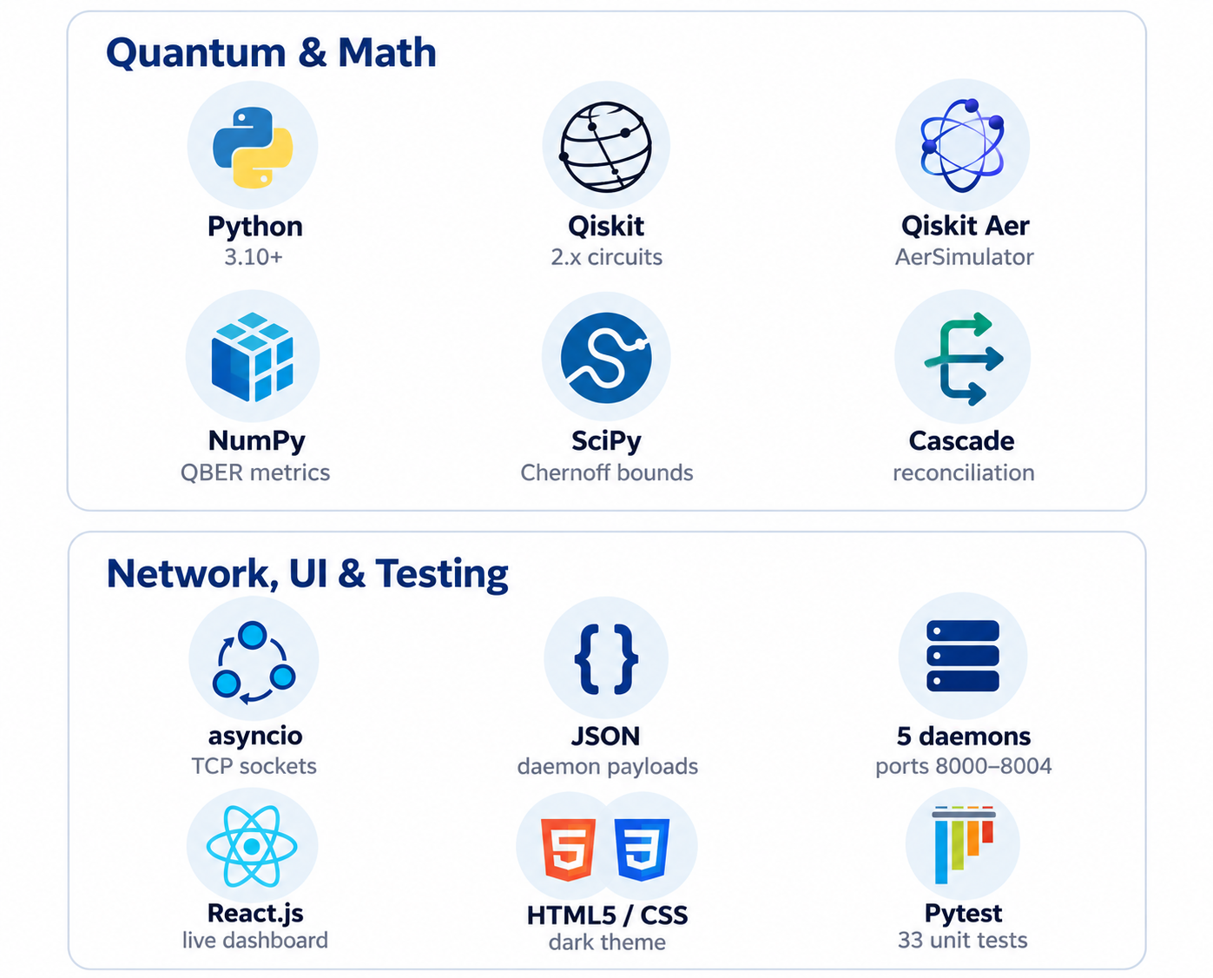
TECHNICAL APPROACH

Slide 4




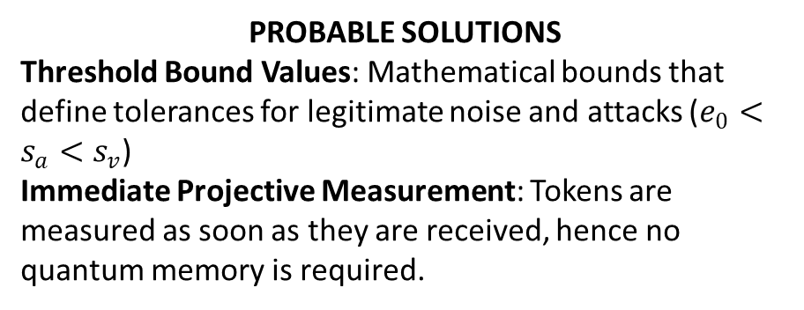
FEASIBILITY AND VIABILITY
FEASIBILITY
Hardware Independent Deployment: Capable of executing completely within conventional computer systems through the Qiskit Aer simulator, not requiring any superconducting hardware.
Extremely Efficient Computational Performance: Instant validation possible with O(1) table lookups and deterministic rules.
LIKELY CHALLENGES
Decoherence on Channels: Noise from the environment (bit/phase flips) can simulate the effects of an eavesdropper.
Memory Lifetime: Long-term quantum memory storage is unfeasible on classical technology and machinery.
PROBABLE SOLUTIONS
Threshold Bound Values: Mathematical bounds that define tolerances for legitimate noise and attacks ($e_{0}<s_{a}<s_{v}$)
Immediate Projective Measurement: Tokens are measured as soon as they are received, hence no quantum memory is required.
RUNS ON STANDARD HARDWARE
React.js dashboard live attack telemetry
Deterministic threat engine O(1) table lookups, rule-based
NOISE vs. ATTACK THRESHOLDS
Qiskit Aer simulator quantum circuits and noise models
e₀
s_{a}
s_{v}
Conventional computer no superconducting hardware needed
Legitimate noise
Safety margin
Attack flagged
mismatch rate (QBER) increases →

Slide 5





IMPACT AND BENEFITS
IMPACTS
Defense & Strategic Sectors: Neutralizes "Harvest Now, Decrypt Later" threats against classified military communications.
FinTech & Banking: Secures high-value transactions with non-repudiable, quantum-proof validation.
Government Infrastructure: Provides tamper-proof authentication for national identity and critical document verification.
BENEFITS
Information-Theoretic Security: Protection backed by physical laws (No-Cloning Theorem), not computational complexity.
Explainable & Auditable: Eliminates black-box AI bias and hallucinations, meeting rigorous regulatory compliance standards.
Zero GPU Overhead: Minimal energy and compute footprint compared to large-scale machine learning threat models.
Conventional
Our approach
Security basis
Math hardness that Shor’s algorithm can break
Physical laws (No-Cloning Theorem)
Defense
FinTech & Banking
Government
Decisions
Black-box ML, false positives
Deterministic and auditable
Blocks “harvest now, decrypt later”
Non-repudiable, quantum-proof transactions
Tamper-proof identity and documents
Compute cost
GPU-heavy threat models
Zero GPU overhead

Slide 6




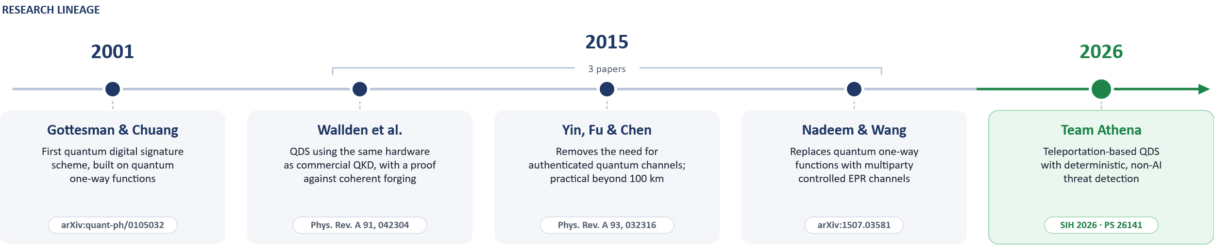
RESEARCH AND REFERENCES
FOUNDATIONAL RESEARCH
Wallden et al. (2015): Quantum digital signatures with quantum key distribution components, Phys. Rev. A / arXiv:1403.5551.
Gottesman & Chuang (2001): Quantum Digital Signatures (arXiv:quant-ph/0105032).
Wang et al. (2015): Quantum Digital Signature Scheme based on Multiparty Controlled EPR Channels (arXiv:1507.03581).
Amiri et al. (2015): Practical Quantum Digital Signature without authenticated quantum channels (arXiv:1507.03333)
CORE PRINCIPLES WE BUILD ON
No-Cloning Theorem
unknown states cannot be copied
Uncertainty Principle
eavesdropping leaves a trace
Quantum Teleportation
Bell pairs + Pauli feed-forward
Chernoff-Hoeffding
finite-sample error bounds

